Slide 1
2017-19
BAYLINERS
STORE
BayLeiners group are a large-scale retail company based in New Zealand, with its operations in various cities across the country, providing a wide range of consumer products.
PRESENTED BY Olusanya Oluwatosin

Slide 2
METHODOLOGY
Data source
The dataset was sourced from Mr. David.
Data Cleaning
Created a data model with four dimension tables (Channel, Customer, Product, Region) and one fact table (Bayliners).
Removed duplicates and blank/error rows from all dimension tables, while preserving the fact table as-is.
Converted the date column from text to a date format using the "Using Locale" function.
Established a primary key (Channel ID) for the Channel dimension table to ensure data integrity.
Tool Used
Powerbi(Power query)
Powerpoint

Slide 3
Delayer
Problem Statement
01
02
03
04
Evaluate the most used channels and their impact on delivery performance.
Assess total revenue, profit, and order count for the year, identifying the top revenue-generating region.
Identify top customers by sales, order count, and revenue, and examine customer distribution and average order value by region.
Determine the highest and lowest revenue-generating products, alongside quantity sold, profit margins, sales trends, and top-performing product categories by region.

Slide 4
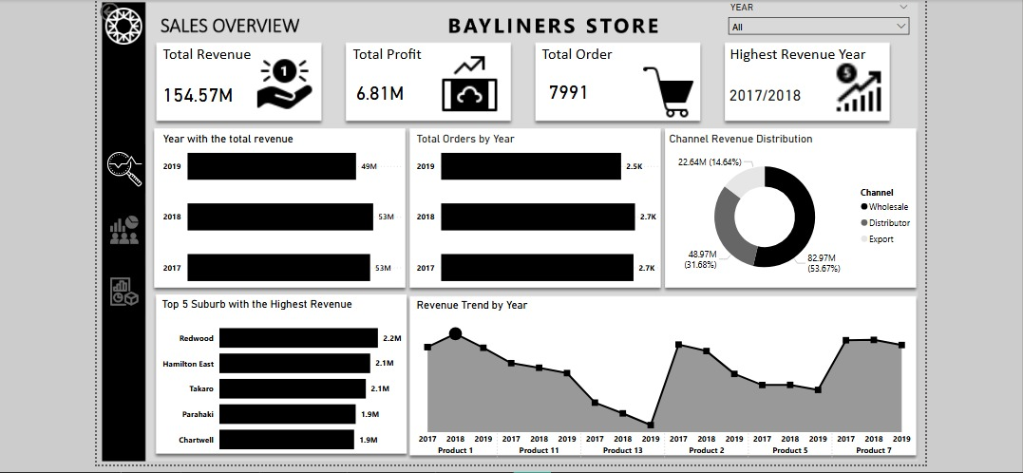
OVERVIEW

Slide 5
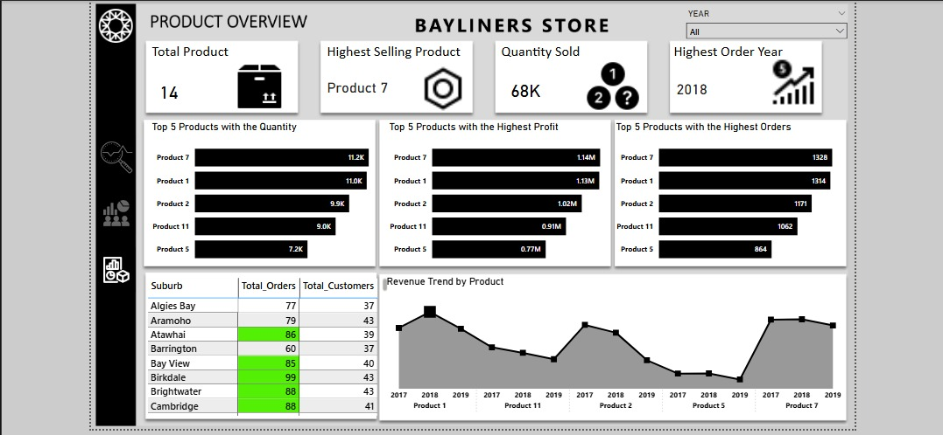
OVERVIEW

Slide 6
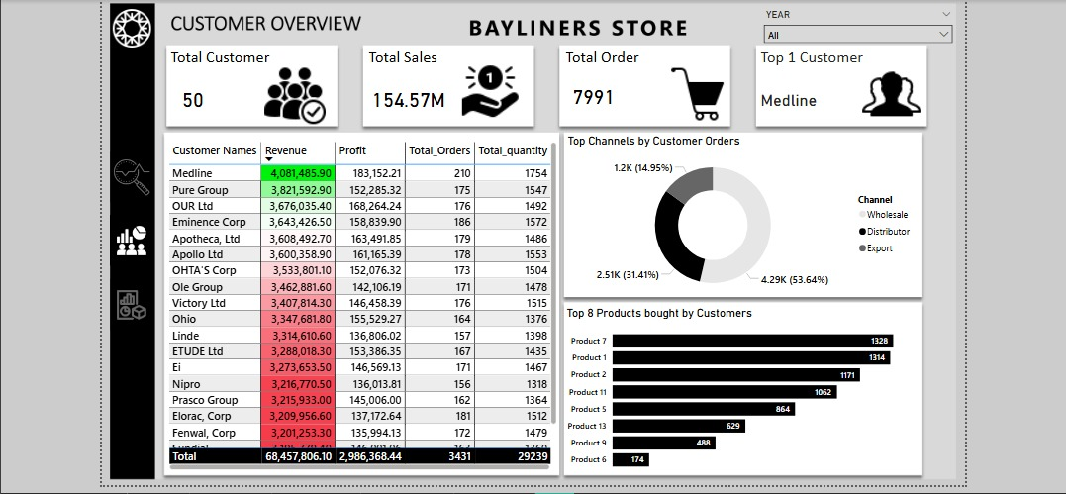
OVERVIEW

Slide 7
PART
1
Sales Overview
Shows bayliners store overview

Slide 8
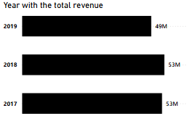
Year with the Total Revenue
1
2017 and 2018 led with 53M in revenue, showcasing a peak year for Bayliners Store with a slight difference in 2019 which had 49M in revenue.

Slide 9
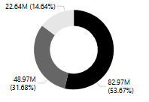
2
14%
Export
Export brought in the lowest share of revenue with 22.64M revenue generated.
Channel Revenue
53.7%
31.7%
Distribution
Wholesales
Distribution also shows a slight big role in the revenue generation with 48.97 revenue generated.
Wholesales shows a high role in revenue generation with 82.97M revenue generated.

Slide 10
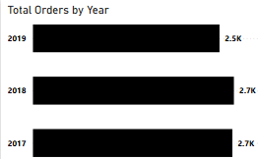
3
Total orders by Year
Orders were much in 2017 and 2018 each with approximately 2.7k orders.

Slide 11
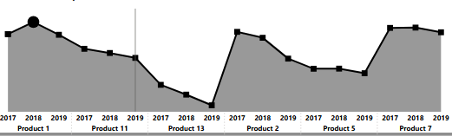
Product Revenue by year
Sales were high in 2017, 2018, and 2019 with Product 1 selling the most which brought in the highest revenue.
Sales dipped mid-period from 2017 to 2019 for product 13.

Slide 12
PART
2
Customer Overview
Contains customer data

Slide 13
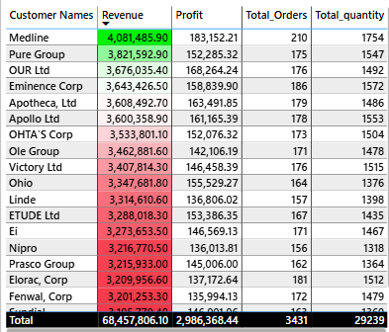
3
Customer Data
The top customer, Mediline, generates 4.08M in revenue with a 183k profit, moving ahead of OUR Ltd. Total revenue reaches 68M, across 3,431 orders.

Slide 14

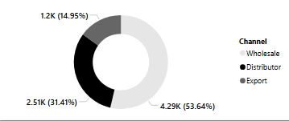
2
Top Channels by Customer Orders.
Wholesales dominates with 1.2k orders followed by Distributor and Export 4.29K orders. From this, it shows that Wholesales is the most preferred channel for Customers.

Slide 15
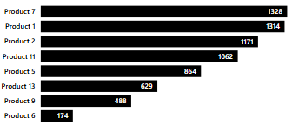
2
Top Channels by Customer Orders.
Product 7 leads with 1328 units sold, followed by product 1 with 1314 units sold. Product 9 lags also with product 6 with 488 and 174 units sold respectively.

Slide 16
PART
3
Product Overview
Shows the tope 5 products by quantity, profit and orders.

Slide 17
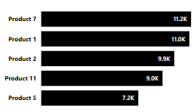
Top 5 Products with the Quantity
Product 7 leads with 11.2k units, followed by Product 1 (11k) and product 2 (9.9k). Product 11 and 5 were less demanded compared to the top 3 products.

Slide 18
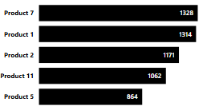
Top 5 Products with the Highest Orders
Product 7 leads with 1328 orders, followed by Product 1 (1314 orders) and product 2 (1171 orders). Product 11 and 5 follow with 1,062 and 864 orders.

Slide 19
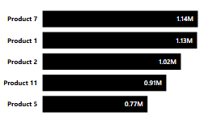
Top 5 Products with the Highest Profit
Product 7 tops with 1.14M profit, followed by Product 1 (1.13M) and product 2 (1.02M). Product 11 and 5 lag compared to the top 3 products.

Slide 20

Recommendations
Capitalize on High-Performing Channels: Focus on Wholesale ($83M) and Distribution ($49M) channels to boost revenue, optimizing their delivery performance.
Promote Top Products: Leverage Product 7 (11.2K sold, $1.14M profit) through targeted marketing to sustain its market dominance.
Expand Product offerings: For product 5, increase its lower quantity orders (7,2k).
Engage Top Customers: Offer loyalty programs for Mediline ($4.081M) to maintain high sales and order volumes.
Targeted growth strategies: Focus on Redwood and Hamilton East suburbs, which lead with 2.2M and 2.1M revenue, for targeted growth.

Slide 21


Conclusion
Bayliners store has strong revenue potential, with 154.57M generated and a peak in 2017-2018. focusing on top suburbs like Redwood and Hamilton East and leveraging high performing products like product 1 and product 7 can sustain and enhance profitability.
Also with wholesale and distribution leading the channel revenue, it can enhance profitability.

Slide 22
Bayliners Store
THANK
YOU!
PRESENTED BY Olusanya Oluwatosin

